Slide 1
Culture
Elements of Culture

Slide 2
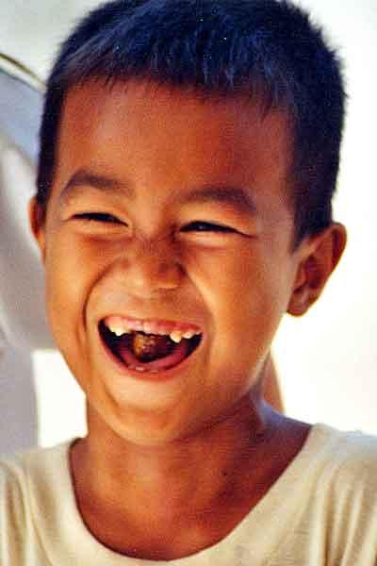
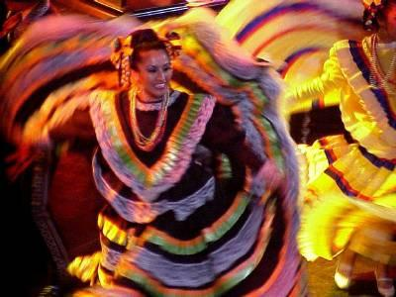
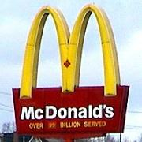
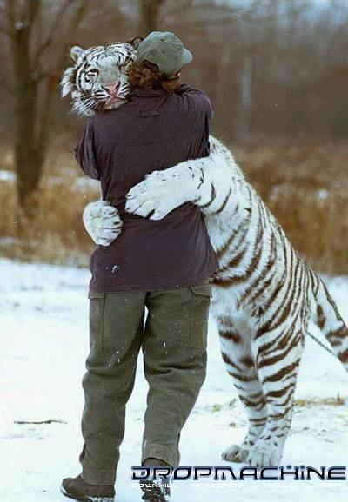
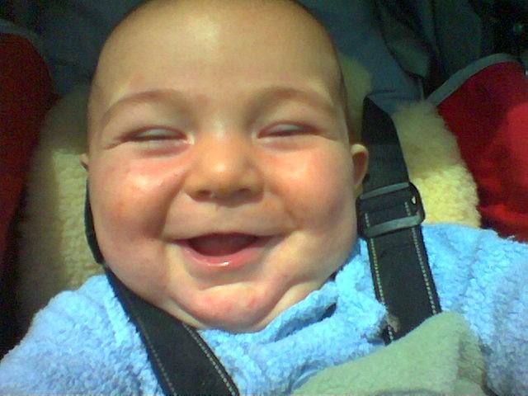
Culture
Culture: everything that makes up a person’s entire way of life

Slide 3
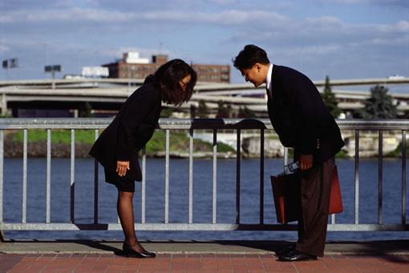
Elements of Culture
Customs and Traditions
- rules of behavior (written and unwritten)

Slide 4
Elements of Culture
Language
Important for communication and passing on traditions and beliefs
There is some debate about making English the official language of the United States.

Slide 5
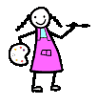
Elements of Culture
Arts and Literature
- teach about a culture’s values
- promote cultural pride and unity
-Could include technology and entertainment

Slide 6
Elements of Culture
Religion
Monotheism: belief in one god
Polytheism: belief in more than one god
Major World Religions
Judaism, Christianity, Islam, Hinduism, Buddhism

Slide 7
7 Elements of Culture
These are things that all cultures have in common.
What might some of those things be?
Social Organization
-When a culture organizes its members into smaller groups
What might some smaller groups be in a culture?
Families
Friends
Religious groups
Social classes
Occupation
Interest groups

Slide 8
7 Elements of Culture
Social Organization, cont.
- family: the most important unit of social organization
Nuclear family- husband, wife, children
Extended family- several generations in one household
- respect for elders is usually strong in extended fams.

Slide 9
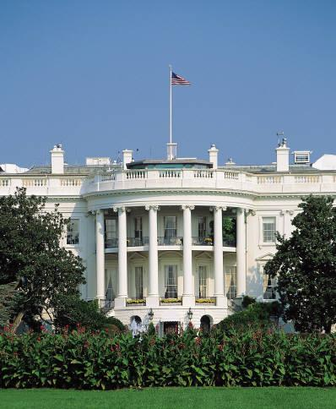
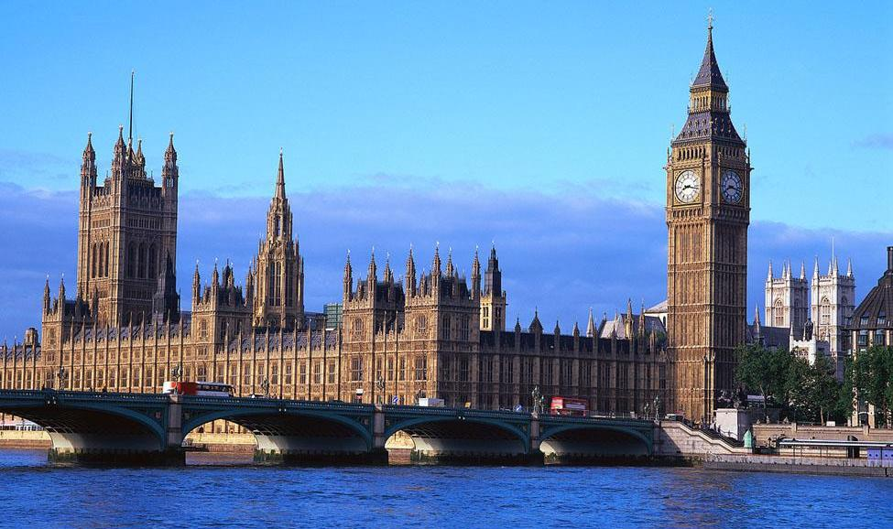
7 Elements of Culture
6. Forms of Government
People form governments to provide for their common needs
Types
Democracy: people have supreme power
Republic: people choose leaders to represent them
Dictatorship: a ruler or group holds power by force
White House
Great Britain’s Houses of Parliament

Slide 10
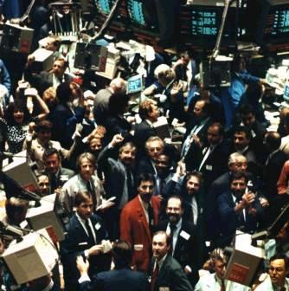
7 Elements of Culture
Economic Systems
Resources a community has
Four types
1. Traditional: people produce most of what they need to survive
2. Market: basic economic questions are answered by buying/selling goods and services
3. Command: government controls answers to economic questions
4. Mixed: individuals make some economic decisions, the government makes others

Slide 11
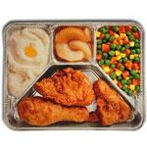
Ways Cultures Change
Technology
Cars, telephone, computers, TV dinners
Environment Changes
New Ideas (like recycling)
4. Diffusion: movement of customs and ideas from one place to another

Slide 12
Be Careful of…
Ethnocentrism: judging other cultures by the standards of your own
Assuming your own culture to be the best
Racism: belief that one racial group is naturally superior to another

